Slide 1
Degree in Computing Year 3 Rich Web Applications
Lecturer: Orla McMahon
TypeScript Essentials

Slide 2
This Week
Overview of Typescript
Creating TypeScript apps

Slide 3
The Limitations of JavaScript
JavaScript is used extensively today, but it has several inherent issues
Because it's a dynamically-typed language
Issues with JavaScript as a dynamically-typed language
No compile-time help, so you hit the bugs at runtime
Limited IntelliSense
Limited tool support for refactoring
Notes:
Intellisense – intelligent code completion
Refactoring is a controlled technique for improving the design of an existing code base without changing the external behaviour

Slide 4
The Role of Statically-Typed Languages
Using a statically-typed language addresses the issues listed on the previous slide
Currently there are more than a hundred languages that compile to JavaScript - see:
https://github.com/jashkenas/coffeescript/wiki/List-of-languages-that-compile-to-JS
The most popular of these languages are:
TypeScript http://www.typescriptlang.org/
CoffeeScript http://coffeescript.org/
Dart https://www.dartlang.org/

Slide 5
TypeScript vs. ECMAScript 6
TypeScript follows the ECMAScript (ES) 6 standards
See http://es6-features.org/
TypeScript also adds:
Types
Interfaces
Decorators (similar to annotations in Java, and attributes in .NET)
Class member variables (i.e. fields)
Generics
public/private keywords
Note on terminology…
ES6 is now officially called ES2015 in the standards documentation
Notes:
Javascript is the language. ES (Ecmascript) is the standard governing Javascript. ES6 is the version of ecmascript draft in which a lot of features were introduced (classes, arrow functions etc).

Slide 6
Using TypeScript for Angular Development
The Angular framework and all the online examples are written in TypeScript
So it's the natural choice for your own code that uses TypeScript
We'll write TypeScript and transpile it into JavaScript
Angular is bundled with type definitions files
So IDEs can perform type checking and offer context-sensitive help
There is very good IDE support for TypeScript and Angular
E.g. Visual Studio 2015 allows you to create TypeScript projects

Slide 7
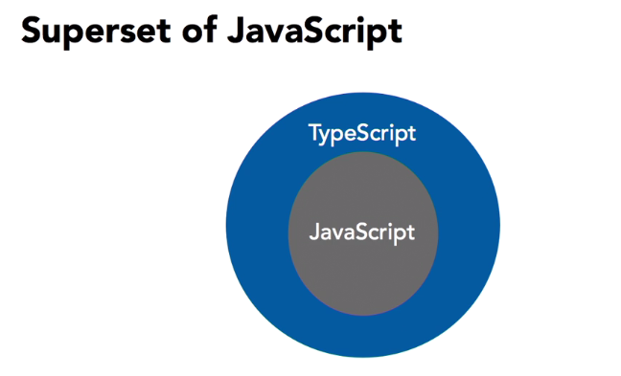
TypeScript
TypeScript is transpiled (compiled) into JavaScript

Slide 8
TypeScript
JavaScript – Dynamic language
Typescript – more static approach
A lot of people define static typing and dynamic typing with respect to the point at which the variable types are checked.
Using this analogy, static typed languages are those in which type checking is done at compile-time, whereas dynamic typed languages are those in which type checking is done at run-time.
Notes:
Big advantage with typeScript is that errors are found at compile time as opposed to run time. Saves in development time. Don’t have to run code to discover errors.

Slide 9
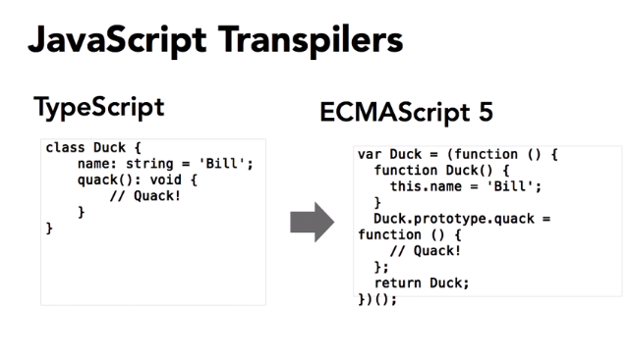
TypeScript
Transpilers transpile one language into an other language

Slide 10
Overview of Transpilation
Web browsers only understand JavaScript
So you must transpile other code (e.g. TypeScript) into JavaScript
Example of transpilation
var personName: string;
class Product {
}
var personName;
var Product = (function () {
function Product() {
}
return Product;
}());
Transpile
TypeScript code
JavaScript code

Slide 11
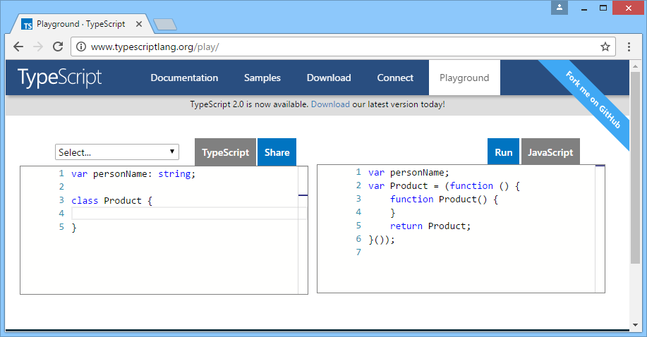
Using the Online TypeScript Playground
There's a handy TypeScript transpiler available online
http://www.typescriptlang.org/play/

Slide 12
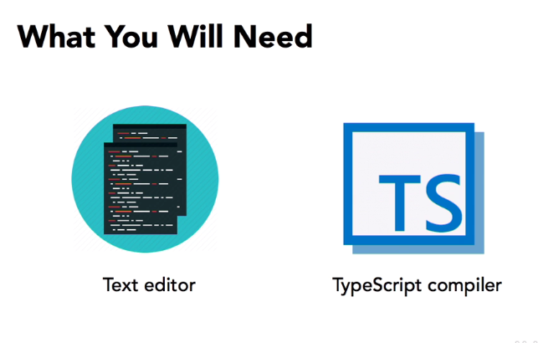
Writing Typescript
typescriptlang.org

Slide 13

Writing Typescript
For most of the popular text editors, such as Sublime Text, TextMate, Atom, Notepad++, Visual Studio Code, it's as simple as searching in their library of extensions and installing the TypeScript feature.

Slide 14
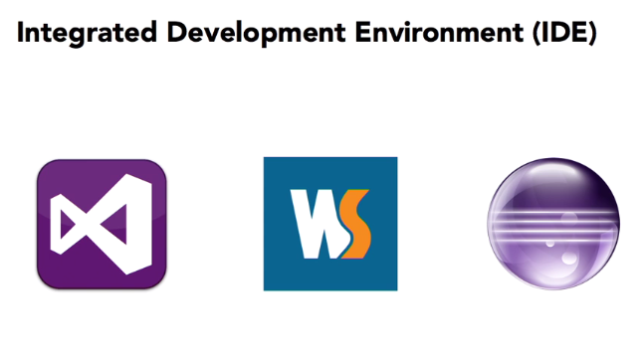
Writing Typescript
There are IDEs,such as Visual Studio, WebStorm, or Eclipse.
Just like the basic text editors, your favorite IDE will likely have great TypeScript support, but some of them may even have the TypeScript compiler built right in.

Slide 15

TypeScript for Eclipse
Typescript for Eclipse
Details at following : http://typecsdev.com/

Slide 16

Writing Typescript using Command Line
Can use command line to work with TypeScript if using basic editor.
Install node.js (includes npm) => nodejs.org
‘npm install –g typescript’ at command line to install typescript compiler
tsc <prog.ts> compiles a typescript file

Slide 17
Writing Typescript using Command Line
When compile .ts file get a .js file (javaScript)

Slide 18
What is Node.js
Node.js is a platform built on Chrome's JavaScript runtime for easily building fast and scalable network applications.
Node.js uses an event-driven, non-blocking I/O model that makes it lightweight and efficient, perfect for data-intensive real-time applications that run across distributed devices.

Slide 19
What is NPM
npm is a NodeJS package manager.
As its name would imply, you can use it to install node programs.
Also, if you use it in development, it makes it easier to specify and link dependencies.

Slide 20
Writing Typescript using Command Line
Also need a server to open up a web page
Can use lite-server that automatically updates your changes in browser
At command line:
npm install –g lite-server
lite-server will execute index.html file

Slide 21
Mac Book Users
sudo npm install –g typescript

Slide 22
TypeScript Benefits
Static Typing means easier to debug
Makes it easier to organize the code base for very large and complicated apps thanks to modules, namespaces and strong OOP support.
TypeScript catches all kinds of errors before they reach runtime and break something.
Angular 2 uses TypeScript

Slide 23
2. Creating TypeScript Apps
Overview
Downloading the TypeScript transpiler
Implementing TypeScript code
Transpiling TypeScript code
Generated JavaScript code
Generated source map file
Referencing script from an HTML page
Viewing the HTML page
Debugging TypeScript code in the browser
Additional techniques

Slide 24
Overview
In this section we'll see how to implement a simple web page using TypeScript
We'll define a Greeter class in TypeScript, which displays a timestamp message every second
We'll transpile the class into JavaScript
We'll load the JavaScript file into an HTML page
To see the demo code:
See the Transpiling folder

Slide 25
Downloading the TypeScript Transpiler
The first step is to download the TypeScript transpiler, which will transpile TypeScript code to JavaScript
You can download the TypeScript transpiler from here
http://www.typescriptlang.org/index.html#download-links
Alternatively you can get the TypeScript transpiler via npm
The -g option installs it globally on your computer…
So it's available from the command line for all your projects
You can verify the TypeScript transpiler version as follows:
npm install -g typescript
tsc --version

Slide 26
Implementing TypeScript Code
Example TypeScript code
Defines a Greeter class in TypeScript
Instantiates Greeter object when page loaded
class Greeter {
element: HTMLElement;
span: HTMLElement;
timerToken: number;
constructor(element: HTMLElement) {
this.element = element;
this.element.innerHTML += "The time is: ";
this.span = document.createElement('span');
this.element.appendChild(this.span);
this.span.innerText = new Date().toUTCString();
}
start() {
this.timerToken = setInterval(
() => this.span.innerHTML = new Date().toUTCString(), 500);
}
stop() {
clearTimeout(this.timerToken);
}
}
window.onload = () => {
var el = document.getElementById('content');
var greeter = new Greeter(el);
greeter.start();
};
app.ts

Slide 27
Transpiling TypeScript Code
Compile the TypeScript code into JavaScript as follows
Generates app.js
Generate a source map file as follows
Generates app.map.js
tsc app.ts
tsc --sourcemap app.ts

Slide 28
Generated JavaScript Code
Here's the generated JavaScript code
We've added the statement at the end, to link the source map file
var Greeter = (function () {
function Greeter(element) {
this.element = element;
this.element.innerHTML += "The time is: ";
this.span = document.createElement('span');
this.element.appendChild(this.span);
this.span.innerText = new Date().toUTCString();
}
Greeter.prototype.start = function () {
var _this = this;
this.timerToken = setInterval(
function () { return _this.span.innerHTML = new Date().toUTCString(); }, 500);
};
Greeter.prototype.stop = function () {
clearTimeout(this.timerToken);
};
return Greeter;
})();
window.onload = function () {
var el = document.getElementById('content');
var greeter = new Greeter(el);
greeter.start();
};
//# sourceMappingURL=app.js.map
Generated app.js file

Slide 29
Generated Source Map File
Here's the generated source map file
Allows you to put breakpoints in your TS code while running it in the browser (even though the code has been transpiled to JS!)
{
"version": 3,
"file": "app.js",
"sourceRoot": "",
"sources": ["app.ts"],
"names": ["Greeter","Greeter.constructor","Greeter.start","Greeter.stop"],
"mappings": "… … …"
}
Generated app.js.map file

Slide 30
Referencing Script from an HTML Page
HTML pages reference the .js file, not the .ts file
<!DOCTYPE html>
<html lang="en">
<head>
<meta charset="utf-8" />
<title>TypeScript HTML App</title>
<link rel="stylesheet" href="app.css" type="text/css" />
<script src="app.js"></script>
</head>
<body>
<h1>TypeScript HTML App</h1>
<div id="content"></div>
</body>
</html>
index.html

Slide 31
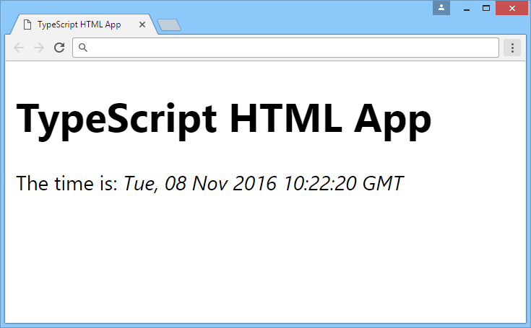
Viewing the HTML Page
This is what the HTML page looks like in the browser

Slide 32
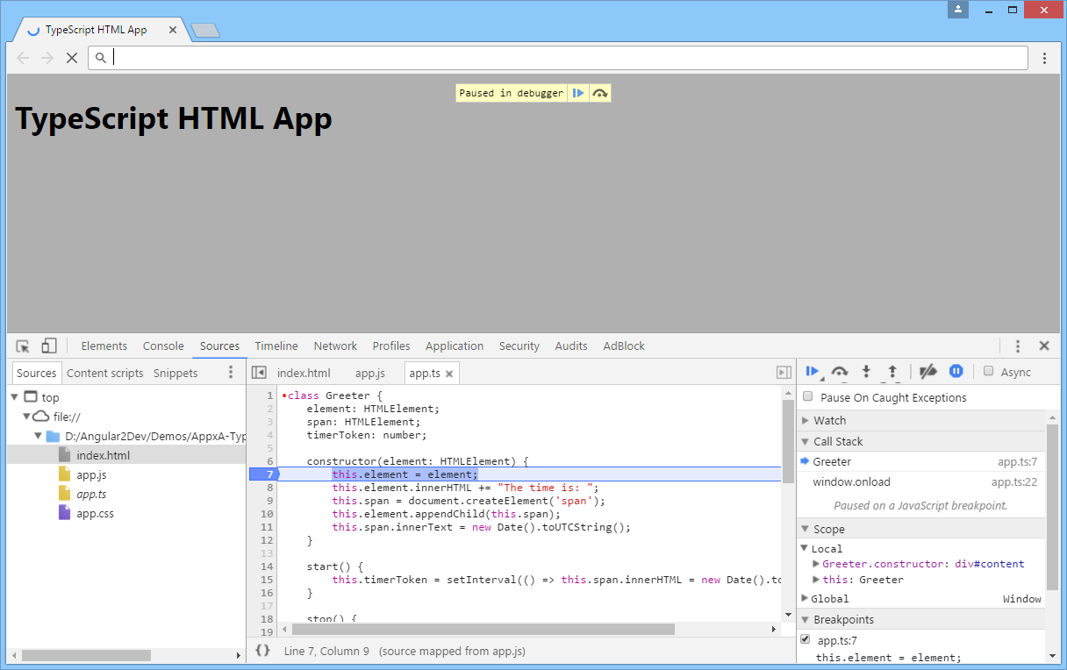
Debugging TypeScript Code in the Browser
In the browser, press F12 to open Development Tools
Set breakpoints in the TypeScript code
Step through the TypeScript code
Notes:
Select Inspect
Click on Source to view source code
Click on side to set breakpoint
F10 to step through code
F8 to run

Slide 33
Additional Techniques (1 of 2)
You can start the TypeScript transpiler in watch mode, via the -w option
Whenever you modify and save your TypeScript code, it's automatically transpiled into JavaScript
tsc -w *.ts

Slide 34
Additional Techniques (2 of 2)
You can define default config options for the TS compiler
Define tsconfig.json file (e.g. in project root folder)
Run tsc without any filenames
For full details, see:
http://www.typescriptlang.org
{
"version": "1.8.10",
"compilerOptions": {
"target": "es6",
"rootDir": ".",
"outDir": "./jsfolder"
}
}
tsconfig.json
tsc

Slide 35
Summary
In this chapter we've presented a high-level overview of TypeScript applications
Defining TypeScript files
Transpilation into JavaScript
Referencing script files in HTML pages
TypeScript Tutorials
http://www.typescriptlang.org

Slide 36
Any Questions?

